Slide 1
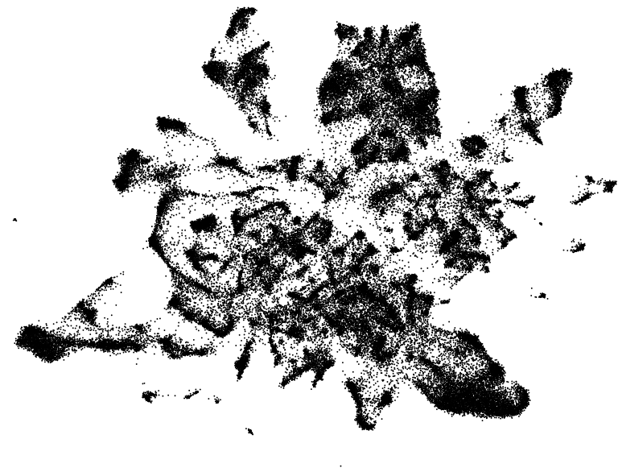
Mouse hypothalamus
single-cell RNA-seq datasets
Merged dataset with all cell types
Filter to
> 1000 UMIs
< 10% mt
Learn neuron annotations
Neuron dataset
Normalization
Highly variable gene selection
PCA
Scanorama
Combat
Seurat-CCA
Harmony
scVI
Evaluation on low-dimensional representation
Select integration method

